Slide 1
Movie Rental
By Jeremy Swartwood

Slide 2


Slide 3
Purpose
To track the rental of movies to customers, while allowing for restricted rentals to minors, and limited liability through tracked late fees.

Slide 4
Overview of features
Web based platform means no installation.
MySQL database reduces product cost.
Redundant and Remote storage of data.

Slide 5
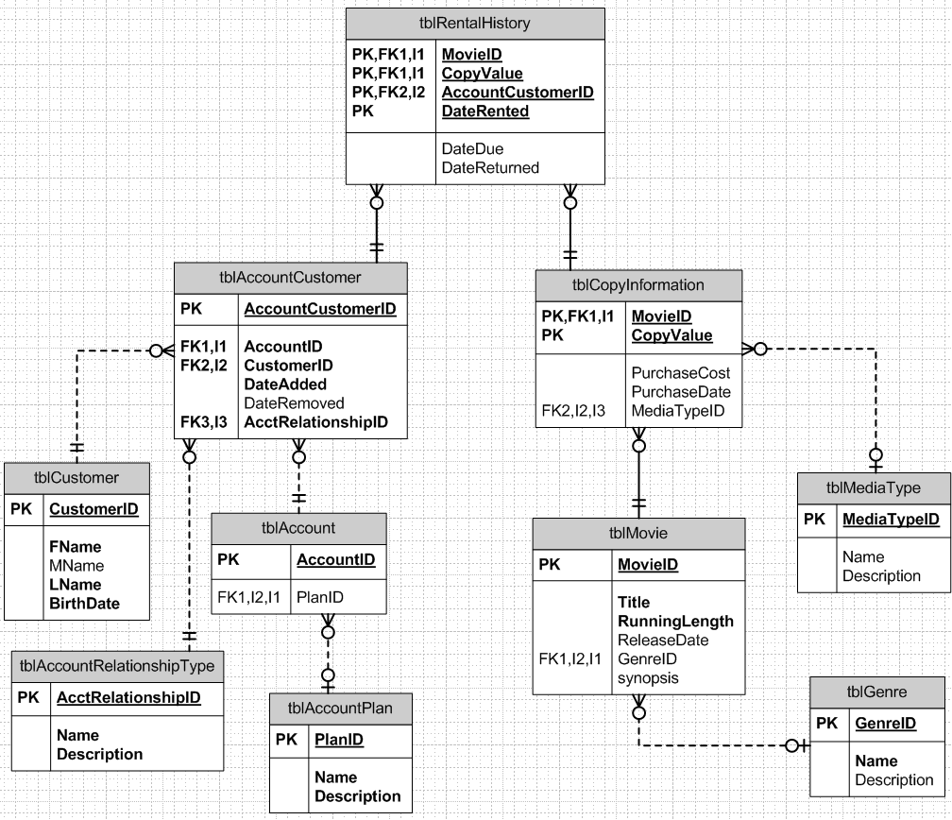
E-R Diagram

Slide 6
Movie Features
Catalog and store.
Alternatively use to track your personal collection of movies.
Search and review.
Per Copy tracking of rental history.

Slide 7
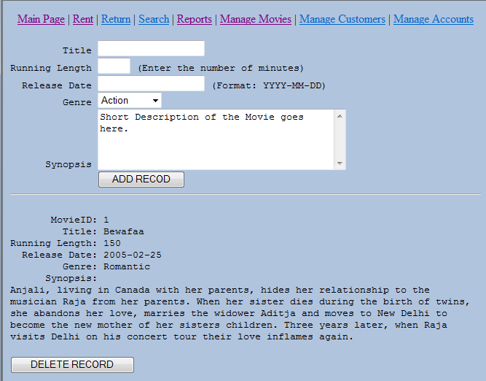
Movie Management

Slide 8
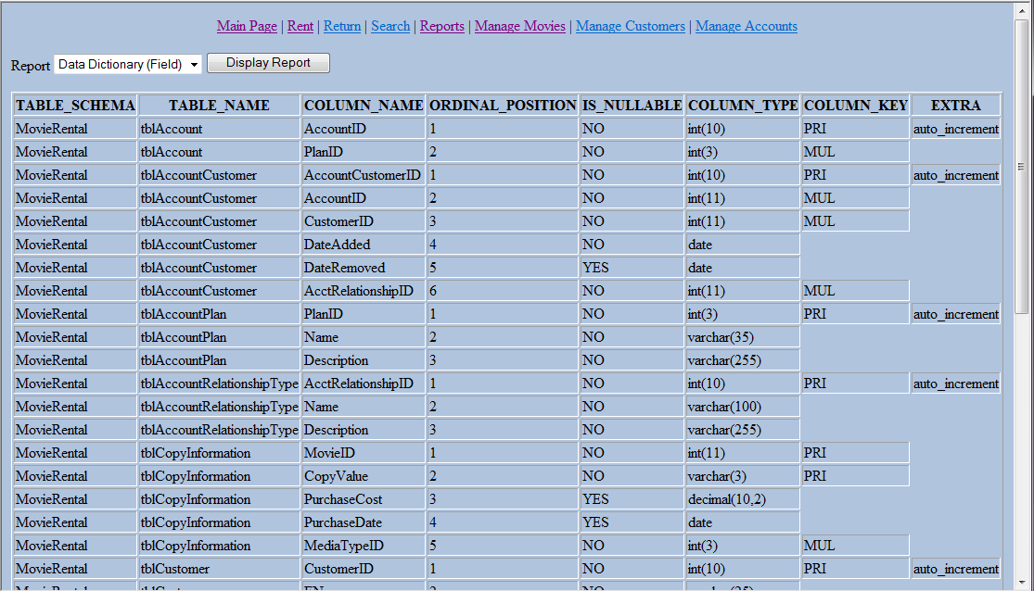
Reports

Slide 9
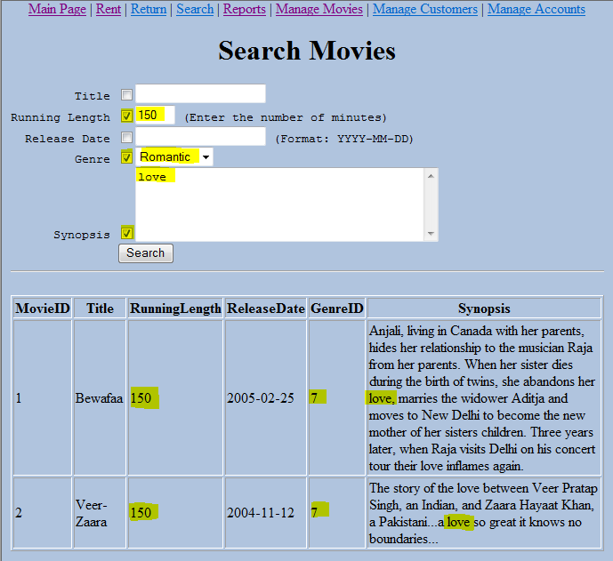
Using HTML forms with checkboxes

Slide 10
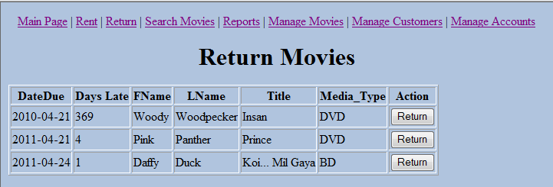
Updating a record using HTML Forms

Slide 11
Customer Features
Create profiles for your customers.
History of movies rented.
Restrict movie rentals based on date of birth.

Slide 12
Account Features
Multiple customers per account.
History of rented movies per account.
Tracking of late fees.

Slide 13
Tracked Movie information
Title of movie
Running length (in minutes)
Release Date
Synopsis.
Per Copy tracking.

Slide 14
Tracked Customer Information
Separated out first, middle, and last name.
Date of Birth

Slide 15
Tracked Rental Information
Date Rented
Number of times rented (through count SQL)
Late Returns

Slide 16
Database and user creation
Database:
CREATE DATABASE MovieRental CHARACTER SET = 'utf8';
User:
CREATE USER 'remoteuser'@'localhost' IDENTIFIED BY 'RemoteUser1';
GRANT SELECT, INSERT, UPDATE, DELETE on MovieRental.* TO 'remoteuser'@'localhost';

Slide 17
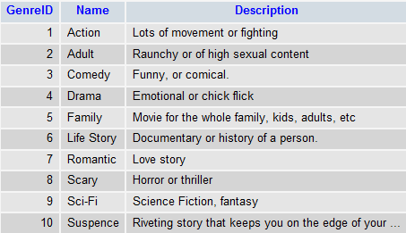
Genre Table
This table holds the different Styles of movies. For instance, Action, Comedy, Scary, etc.
CREATE TABLE tblGenre(
GenreID int(3) NOT NULL AUTO_INCREMENT,
Name varchar(30) NOT NULL,
Description varchar(255),
CONSTRAINT pk_tblGenre PRIMARY KEY (GenreID));

Slide 18
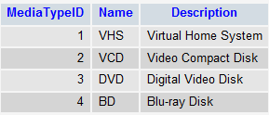
Media Type Table
The different possible formats the movie can be rented in. VHS, VCD, DVD, BD.
CREATE TABLE tblMediaType(
MediaTypeID INT(3) NOT NULL AUTO_INCREMENT,
Name VARCHAR(30),
Description VARCHAR(255),
CONSTRAINT pk_tblMediaType PRIMARY KEY (MediaTypeID));

Slide 19
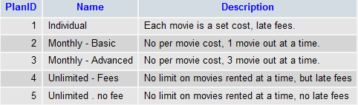
Account Plan Table
Each plan has a specific way it will charge the user. Monthly, per dvd, late fees, etc.
CREATE TABLE tblAccountPlan(
PlanID INT(3) NOT NULL AUTO_INCREMENT,
Name VARCHAR(35) NOT NULL,
Description VARCHAR(255) NOT NULL,
CONSTRAINT pk_tblAccountPlan PRIMARY KEY (PlanID));

Slide 20
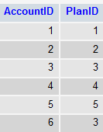
Account table
This is to store the unique account numbers and the plan that the account has.
CREATE TABLE tblAccount (
AccountID INT(10) NOT NULL AUTO_INCREMENT,
PlanID INT(3) NOT NULL,
CONSTRAINT pk_tblAccount PRIMARY KEY (AccountID),
CONSTRAINT fk_tblAccount FOREIGN KEY (PlanID) REFERENCES tblAccountPlan(PlanID));

Slide 21
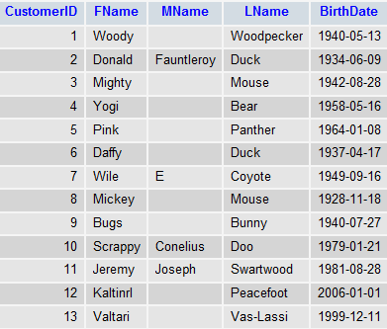
Customer Table
List of all the customers.
CREATE TABLE tblCustomer (
CustomerID int(10) NOT NULL AUTO_INCREMENT,
FName VARCHAR(25) NOT NULL,
MName VARCHAR(25),
LName VARCHAR(25) NOT NULL,
BirthDate DATE NOT NULL,
CONSTRAINT pk_tblCustomer PRIMARY KEY (CustomerID));

Slide 22
Movie Table
Each plan has a specific way it will charge the user. Monthly, per dvd, late fees, etc.
CREATE TABLE tblMovie(
MovieID int(10) NOT NULL AUTO_INCREMENT,
Title VARCHAR(255) NOT NULL,
RunningLength INTEGER NOT NULL,
ReleaseDate DATE,
GenreID INT(3) NOT NULL,
Synopsis blob,
CONSTRAINT pk_tblMovie PRIMARY KEY (MovieID),
CONSTRAINT fk_tblMovieGenre FOREIGN KEY (GenreID) REFERENCES tblGenre(GenreID));
NOTE: The blob field allows for more than 255 characters.
**Image of data moved to the next page.

Slide 23
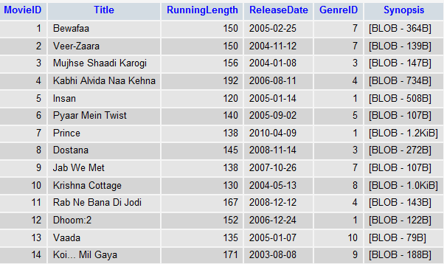
Movie Table cont…

Slide 24
Copy Information Table
Stores the details on each copy of a movie. Media Type, Purchase cost, Puchase date, etc.
CREATE TABLE tblCopyInformation (
MovieID INTEGER NOT NULL,
CopyValue VARCHAR(3) NOT NULL,
PurchaseCost DECIMAL(10,2),
PurchaseDate DATE,
MediaTypeID INT(3) NOT NULL,
CONSTRAINT pk_tblCopyInfo PRIMARY KEY (MovieID, CopyValue),
CONSTRAINT fk_tblCopyInfo FOREIGN KEY (MovieID) REFERENCES tblMovie(MovieID),
CONSTRAINT fk_tblCopyInfo2 FOREIGN KEY (MediaTypeID) REFERENCES tblMediaType(MediaTypeID));
**Image of data moved to the next page.

Slide 25
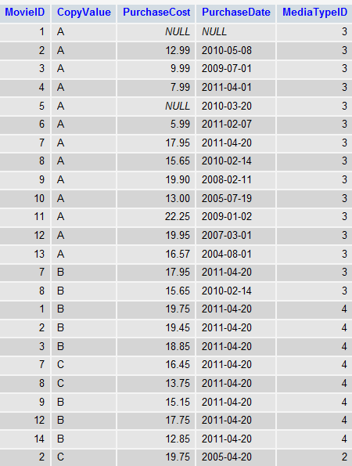
Copy Information Table Cont…

Slide 26

Account Relationship Type Table
Another lookup table. This one stores information about the different types of account relationships customers can have.
CREATE TABLE tblAccountRelationshipType (
AcctRelationshipID int(10) NOT NULL AUTO_INCREMENT,
Name VARCHAR(100) NOT NULL,
Description VARCHAR(255) NOT NULL,
CONSTRAINT pk_tblAcctRelateType PRIMARY KEY (AcctRelationshipID));

Slide 27
Account Customer Table
Stores the which customers are on what accounts. Including the type of relationship they have on that account.
CREATE TABLE tblAccountCustomer (
AccountCustomerID int(10) NOT NULL AUTO_INCREMENT,
AccountID INTEGER NOT NULL,
CustomerID INTEGER NOT NULL,
DateAdded DATE NOT NULL,
DateRemoved DATE,
AcctRelationshipID INTEGER NOT NULL,
CONSTRAINT pk_tblAcctCust PRIMARY KEY (AccountCustomerID),
CONSTRAINT fk_tblAcctCust1 FOREIGN KEY (AccountID) REFERENCES tblAccount(AccountID),
CONSTRAINT fk_tblAcctCust2 FOREIGN KEY (CustomerID) REFERENCES tblCustomer(CustomerID),
CONSTRAINT fk_tblAcctCust3 FOREIGN KEY (AcctRelationshipID) REFERENCES tblAccountRelationshipType (AcctRelationshipID));
**Image of data moved to the next page.

Slide 28
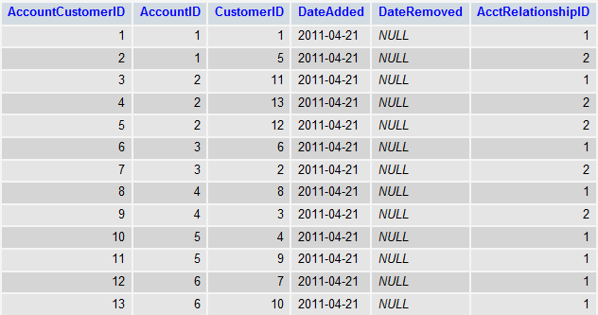
Account Customer Table Cont…

Slide 29
Rental History Table
Information on each copy of a movie rented, which customer rented it, details about when it was rented and when it is due.
CREATE TABLE tblRentalHistory (
MovieID INTEGER NOT NULL,
CopyValue VARCHAR(3) NOT NULL,
AccountCustomerID INTEGER NOT NULL,
DateRented DATE NOT NULL,
DateDue DATE,
DateReturned DATE,
CONSTRAINT pk_tblRentalHistory PRIMARY KEY (MovieID, CopyValue, AccountCustomerID, DateRented),
CONSTRAINT fk_tblRentalHistory1 FOREIGN KEY (MovieID, CopyValue) REFERENCES tblCopyInformation (MovieID, CopyValue),
CONSTRAINT fk_tblRentalHistory2 FOREIGN KEY (AccountCustomerID) REFERENCES tblAccountCustomer (AccountCustomerID));
**Image of data moved to the next page.

Slide 30
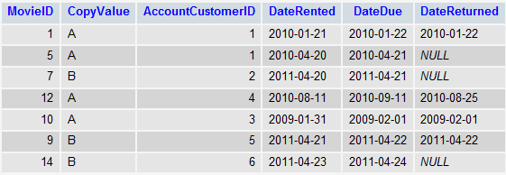
Rental History Table Cont…

Slide 31
4 Simple Select Queries (6a)
Find all movies that are less than 2 hours 10 mins.
SELECT * FROM tblMovie WHERE RunningLength<130;
Find all customers who do not have a middle initial or name.
SELECT * FROM tblCustomer WHERE MName IS NULL;

Slide 32
4 Simple Select Queries (6a) Cont…
Find all movies that were purchased for less than $10.
SELECT * FROM tblCopyInformation WHERE PurchaseCost<10;
Get the list of all the different types of Genres
SELECT * FROM tblGenre;

Slide 33
4 Order by/Group by Queries (6b)
Get all Movies sorted by Movie Name A-Z.
SELECT MovieID, Title, RunningLength
FROM tblMovie ORDER BY Title ASC;

Slide 34
4 Order by/Group by Queries (6b) Cont…
Find the MovieID for all movies that have 2 or more copies.
SELECT MovieID, COUNT(*) AS TOTAL_COPIES
FROM tblCopyInformation
GROUP BY MovieID
HAVING COUNT(*) > 1
ORDER BY COUNT(*) DESC;

Slide 35
4 Order by/Group by Queries (6b) Cont…
All customers in last name, first name, middle name in A-Z order, that have FName and Lname starting with ‘D’.
SELECT *
FROM tblCustomer
WHERE LName like 'D%' AND FName like 'D%'
ORDER BY LName, FName, Mname;

Slide 36
4 Order by/Group by Queries (6b) Cont…
List all customers who are younger than 18 in descending order.
select C.CustomerID,
C.Fname,
C.Lname,
((date_format(now(),'%Y') - date_format(C.BirthDate,'%Y')) - (date_format(now(),'00-%m-%d') < date_format(C.BirthDate,'00-%m-%d'))) AS age
from tblCustomer C
Where ((date_format(now(),'%Y') - date_format(C.BirthDate,'%Y')) - (date_format(now(),'00-%m-%d') < date_format(C.BirthDate,'00-%m-%d'))) < 18
order by 2 desc;

Slide 37
4 Join Queries (7A)
List all customers on an account, including the relationship type:
select C.FName, C.LName, C.BirthDate, TART.Name Acct_Relation_Type, TAC.DateAdded, TA.AccountID, TAP.Name Acct_Plan
from tblCustomer C
inner join tblAccountCustomer TAC on TAC.CustomerID = C.CustomerID
inner join tblAccountRelationshipType TART on TART.AcctRelationshipID = TAC.AcctRelationshipID
inner join tblAccount TA on TA.AccountID = TAC.AccountID
inner join tblAccountPlan TAP on TAP.PlanID = TA.PlanID;

Slide 38
4 Join Queries (7A) Cont…
Show all Movies overdue:
SELECT M.Title, CI.CopyValue, RH.DateRented, RH.DateDue, DATEDIFF(sysdate(),RH.DateDue) 'Days Late', TC.FName, TC.LName, TART.Name RelationshipType, TAP.Name 'Account Plan', TAP.Description 'Account Plan Description'
FROM tblMovie M
JOIN tblCopyInformation CI ON CI.MovieID = M.MovieID
JOIN tblRentalHistory RH ON RH.MovieID = CI.MovieID AND RH.CopyValue = CI.CopyValue
JOIN tblAccountCustomer TAC ON TAC.AccountCustomerID = RH.AccountCustomerID
JOIN tblAccount TA ON TA.AccountID = TAC.AccountID
JOIN tblAccountPlan TAP ON TAP.PlanID = TA.PlanID
JOIN tblCustomer TC on TC.CustomerID = TAC.CustomerID
JOIN tblAccountRelationshipType TART ON TART.AcctRelationshipID = TAC.AcctRelationshipID
WHERE RH.DateReturned IS NULL

Slide 39
4 Join Queries (7A) Cont…
Show all movies detailing the Genre, Media type, and Copy:
Select M.Title,
TG.Name Genre,
TMT.Name Media_Type,
TCI.CopyValue
FROM tblMovie M
Inner join tblCopyInformation TCI
on TCI.MovieID = M.MovieID
Inner join tblMediaType TMT
on TMT.MediaTypeID = TCI.MediaTypeID
Inner join tblGenre TG
on TG.GenreID = M.GenreID
ORDER BY M.Title, TCI.CopyValue;

Slide 40
4 Join Queries (7A) Cont…
Find Breakdown of number of movies per Genre.
SELECT TG.Name Genre, COUNT(M.MovieID) Num_of_Genre
FROM tblGenre TG
LEFT JOIN tblMovie M
ON TG.GenreID = M.GenreID
GROUP BY TG.Name
ORDER BY 2 DESC, TG.Name ASC;

Slide 41
4 Subqueries/in/exists (7B)
Find the number of movies rented per each Customer.
SELECT TC.FName, TC.LName, Coalesce(TAC.MoviesRented,0) Movies_Rented
FROM tblCustomer TC
LEFT JOIN (SELECT CustomerID, count(*) MoviesRented
FROM tblRentalHistory T1
INNER JOIN tblAccountCustomer T2
ON T2.AccountCustomerID = T1.AccountCustomerID
GROUP BY CustomerID) TAC
ON TAC.CustomerID = TC.CustomerID
GROUP BY TC.FName, TC.Lname
ORDER BY 3 desc;

Slide 42
4 Subqueries/in/exists (7B) Cont…
Find all the movies where there is not a Blue Ray Disk Copy
SELECT Title
FROM tblMovie M
WHERE NOT EXISTS (SELECT 1
FROM tblCopyInformation TCI
WHERE TCI.MovieID = M.MovieID
AND TCI.MediaTypeID = 4);
Find all the movies where the Genre is not in a specific set of genres
SELECT MovieID, Title
FROM tblMovie M
WHERE M.GenreID NOT IN (1,5,7,4)
ORDER BY Title DESC;

Slide 43
4 Subqueries/in/exists (7B) Cont…
Find all Action, Drama, or Suspense movies, where the Title has “NA” in it somewhere.
SELECT M.Title, TG.Name Genre, M.ReleaseDate, M.RunningLength
FROM tblMovie M
INNER JOIN tblGenre TG
ON TG.GenreID = M.GenreID
WHERE lower(M.Title) like '%na%' and M.GenreID in (1,4,10);

Slide 44
Indexes to enhance query speed
Index created for Query #3 in Section 6B. Allows for faster customer lookup by Name (first). CREATE INDEX index_empfname ON tblCustomer(FName);
Index created for Query #3 in Section 6B. Allows for faster customer lookup by Name (last). CREATE INDEX index_emplname ON tblCustomer(LName);
Index created for Query #1 in Section 6A. Allows for faster movie lookup by Running Length. CREATE INDEX index_runlength ON tblMovie(RunningLength);
Index created for Query #4 in Section 7B. Allows for faster movie lookup by searching for the Title. CREATE INDEX index_title ON tblMovie(Title);

